Slide 1
ICP Presentation 2
Nathan Cheney
Joe Moon

Slide 2
Introduction
ICP Group 3
  Joe Moon
  Nathan Cheney
Video Link: https://youtu.be/KbCoEtOTDXQ
GitHub Repositories
  Joe Moon: https://github.com/joemoon-0/WebMobile-2022Spring/tree/main/2022Spring-Mobile
  Nathan Cheney: https://github.com/nathancheney/Web-Mobile-Programming

Slide 3
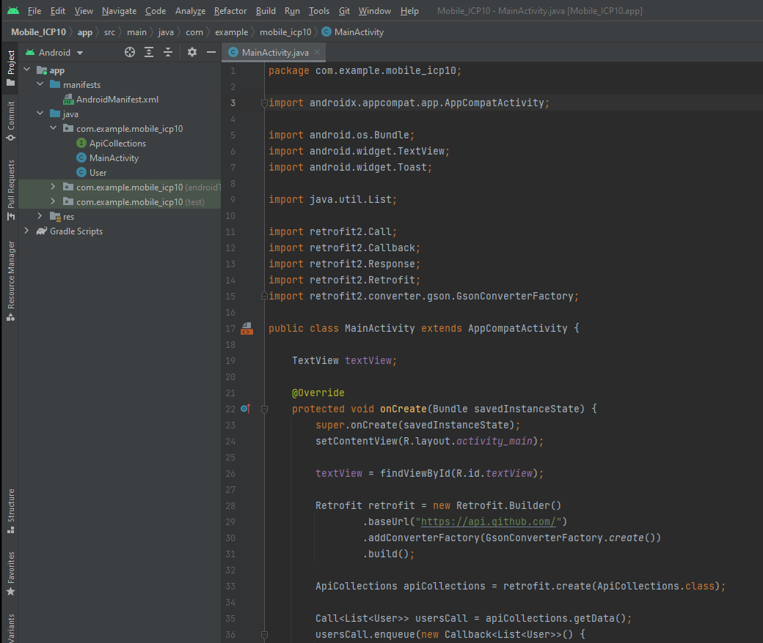
Mobile Application Development
Android Studio
Emulators for testing
Library Imports

Slide 4
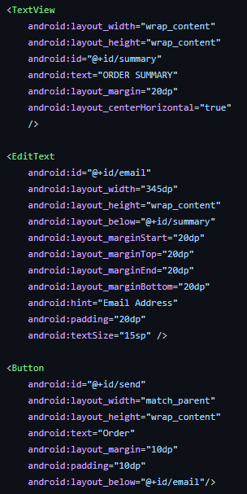
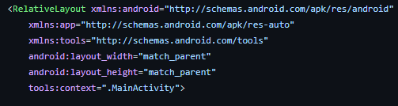
Features – User Interface
Creating User Interfaces using:
  TextView → Display text
  EditText → Receive inputs
  Button → Initiate a function
Layouts
  Relative Layout → positioning of features

Slide 5
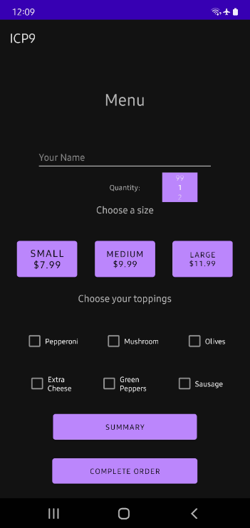
User Interface Example
Relative Layout used
All features positioned relative to
surrounding features.
Features are constrained top, left, right
and bottom.
Colors, fonts, and sizing are optional
parameters for asthetics.

Slide 6
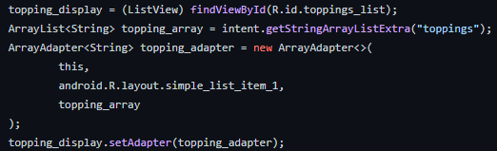
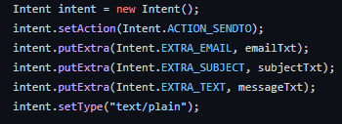

Features - Views and Intents
Views → used to display information from data structures
  ListView used to display data from an ArrayList<String>
  An Adapter then outputs that information to the UI
Intents → navigate and pass information between views

Slide 7
Features – Text-to-Speech (TTS)
TTS for additional app accessibility
Android native library
Event Listener
  Set language
  Translate text
  onPause → stop playback when app is out of focus
  onDestroy → release TTS resources

Slide 8
Thanks!

